Slide 1



Samsung Innovation Campus
Deen Dayal Upadhyaya Gorakhpur university
C&P Course

Slide 2
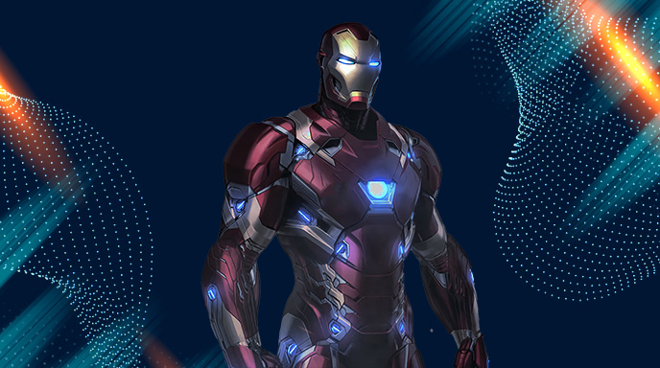

JARVIS
A Python-based Voice and Command Assistant
Team Jarvis
Gaurav, Shivansh, Amit, Anant, Kamran Coding and Programming Course

Slide 3

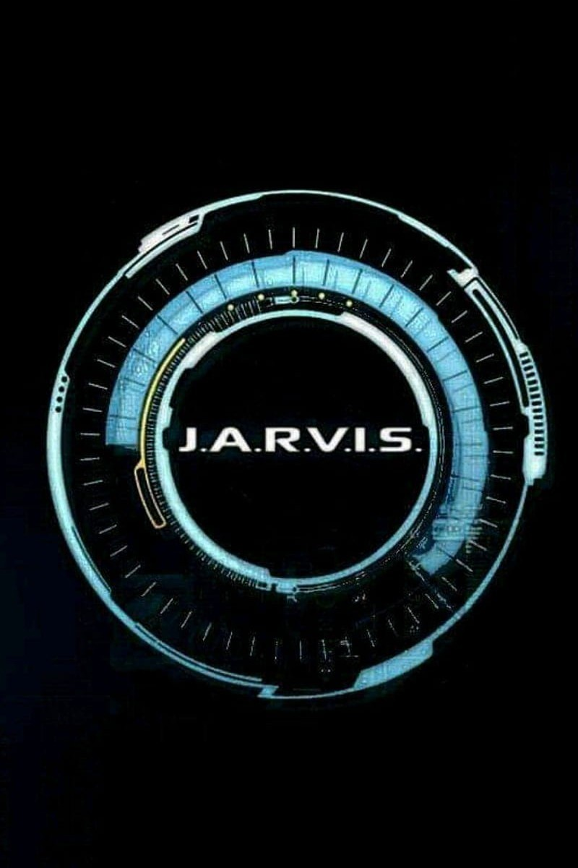
Welcome to J.A.R.V.I.S: The Artifficial Genius
Dive into the fascinating world of
J.A.R.V.I.S
The purpose here is to create a personal assistant that can perform various tasks based on voice and text commands

Slide 4

The Birth of J.A.R.V.I.S
Learn about the origins of J.A.R.V.I.S, Tony Stark's personal assistant and artiﬁcial intelligence. Discover how this groundbreaking technology was developed and its early integration with the Iron Man suit.
Likewise we have made this to power up our desktop devices , it will help in giving commands to a system in more easy and convinient way .

Slide 5

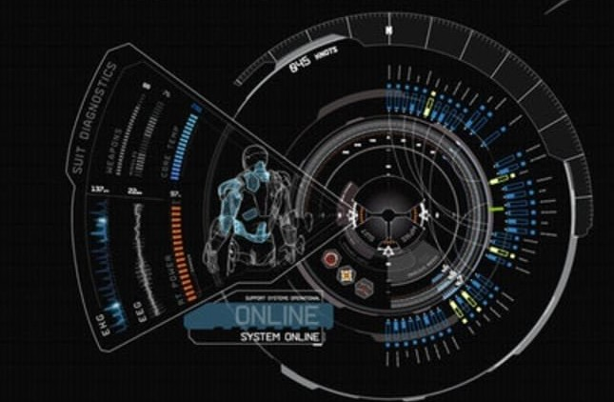
J.A.R.V.I.S's Capabilities
Voice and text command recognition Search Wikipedia
Open popular websites (YouTube, Google, Stack Overﬂow)
Get the current time Open Visual Studio Code
Retrieve system information (CPU and
memory usage)

Slide 6
J.A.R.V.I.S's
Evolution(Technologies Used)
Python: Main programming language tkinter: GUI library for creating the interface pyttsx3: Text-to-speech conversion
speech_recognition: Recognizing and interpreting voice commands PIL (Pillow): Image processing
psutil: System and process utilities
wikipedia API: Fetching information from Wikipedia

Slide 7

Code Structure
wish_me(): Greets the user based on the time of day
take_command(): Listens for voice commands and converts them to text perform_task(): Executes tasks based on the command search_wikipedia(): Fetches summary from Wikipedia
get_system_info(): Retrieves CPU and memory usage open_website(): Opens speciﬁed URLs
gui_main(): Initializes and runs the GUI

Slide 8

Future Enhancements
Add more functionalities (e.g., email sending, weather updates)
Improve voice recognition accuracy Integrate with other APIs for more features
Enhance GUI design for better user experience

Slide 9

Thanks!
Don't Ask any questions , as
i'm in developing phase , Who knows, whether I'll turn into
Jarvis or Ultron

